Slide 1
Ferroelectricity
ECE658 Discussion Presentation
Yifan Wang
Instructor: Prof. Peide Ye
April. 15, 2026

Slide 2
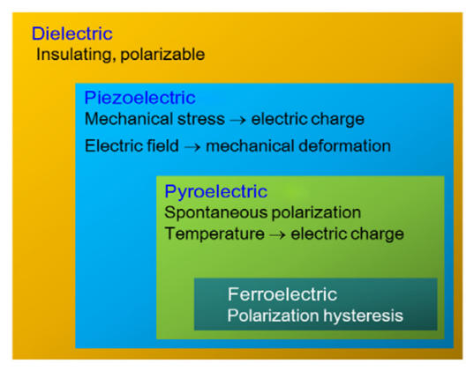
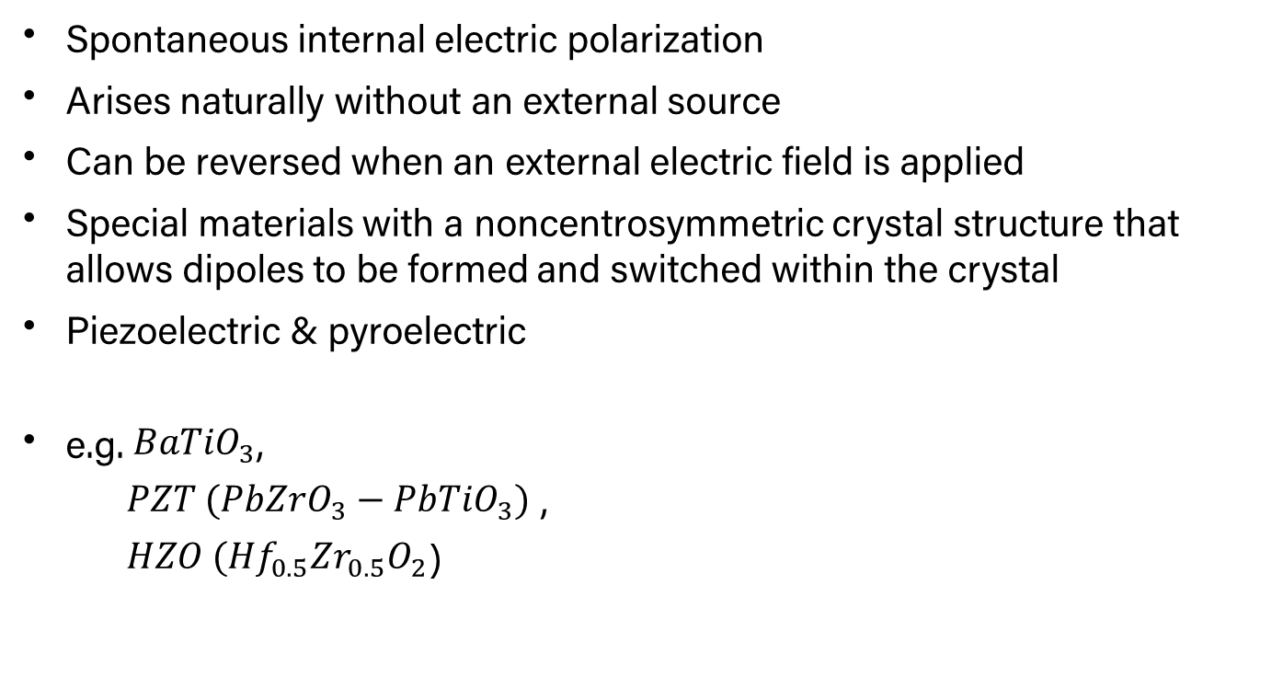
Introduction
Property of certain materials
Spontaneous internal electric polarization
Arises naturally without an external source
Can be reversed when an external electric field is applied
Special materials with a noncentrosymmetric crystal structure that allows dipoles to be formed and switched within the crystal
Piezoelectric & pyroelectric
e.g. ${BaTiO}_{3}$,
${PZT ({PbZrO}_{3}−PbTiO}_{3})$ ,
${HZO ({Hf}_{0.5}{Zr}_{0.5}O}_{2}$)
Notes:
Ferroelectricity is the property of certain materials that exhibit a spontaneous electric polarization—an internal electric alignment that arises naturally without an external source. This polarization can be reversed when an external electric field is applied.
This property is only observed in special materials with a noncentrosymmetric crystal structure that allows dipoles to be formed and switched within the crystal.
All ferroelectric materials are also piezoelectric (they generate an electric charge when mechanically stressed) and pyroelectric (they generate a charge when heated or cooled).
The term ferroelectricity was coined in analogy to ferromagnetism, where a material exhibits a permanent magnetic moment. Ferromagnetism was already well established when ferroelectricity was first observed in 1920 in Rochelle salt by American physicist Joseph Valasek. The prefix ferro (meaning iron) was adopted even though most ferroelectric materials do not contain iron.
e.g. Barium titanate, lead zirconate–lead titanate , hafnium zirconium oxide (modern emerging materials, CMOS-compatible, thin-film scalable)

Slide 3
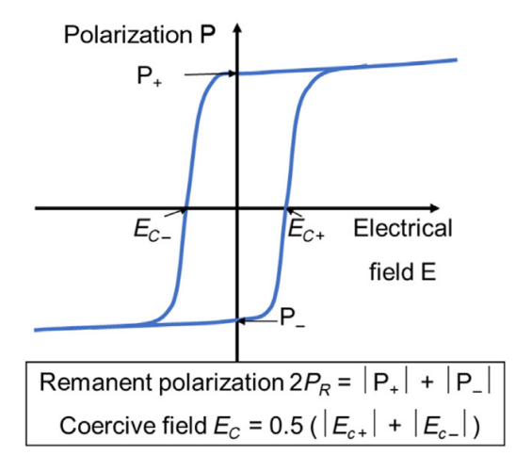
Polarization Switching
P-E hysteresis loop
The switchable polarization gives rise to a hysteresis curve of the polarization versus electrical field behavior.
Ideal candidate for a binary nonvolatile memory
Electric field & current to switch polarization states
Notes:
The switchable polarization gives rise to a hysteresis curve of the polarization versus electrical field behavior as shown in Fig. If we identify the two remnant polarization points at zero applied electric field as “0” and “1,” it becomes clear that such material will be an ideal candidate for a binary nonvolatile memory.
It does not only have two stable polarization points, but switching between them is done purely by applying an electrical field and only the current to move the involved ions in the crystal from the one stable lattice position to the other one needs to be supplied.

Slide 4
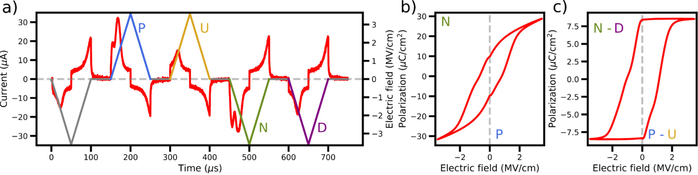
How We Measure P-E
PUND measurement, Ferroelectric capacitor
Prepolling pulse, First positive pulse (P), Second positive pulse (U), First negative pulse (N), Second negative pulse (D)
P–E hysteresis is derived from the “P–U” and “N–D” sequences, with dielectric and leakage contributions removed to isolate the FE response.
Notes:
Prepolling pulse: this pulse aligns the FE domains along a specific direction, given by the voltage polarity (e.g., downward).
First positive pulse (P): switches the FE domains in the opposite direction (e.g., upward); the associated current response includes contributions due to domain switching, dielectric, and leakage currents.
Second positive pulse (U): assuming no domain switching during the relaxation step, this pulse can be used to measure other nonswitching currents.
First negative pulse (N): switches domains in the opposite direction (e.g., downward); as for the P counterpart the current response includes contributions due to domain switching, dielectric, and leakage currents.
Second negative pulse (D): as for the U sequence, this pulse is used to measure other contributions to the current, which are not due to the domain switching.

Slide 5
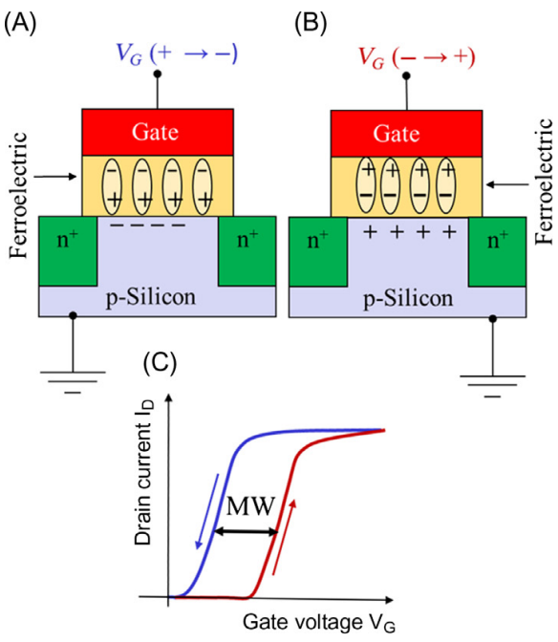
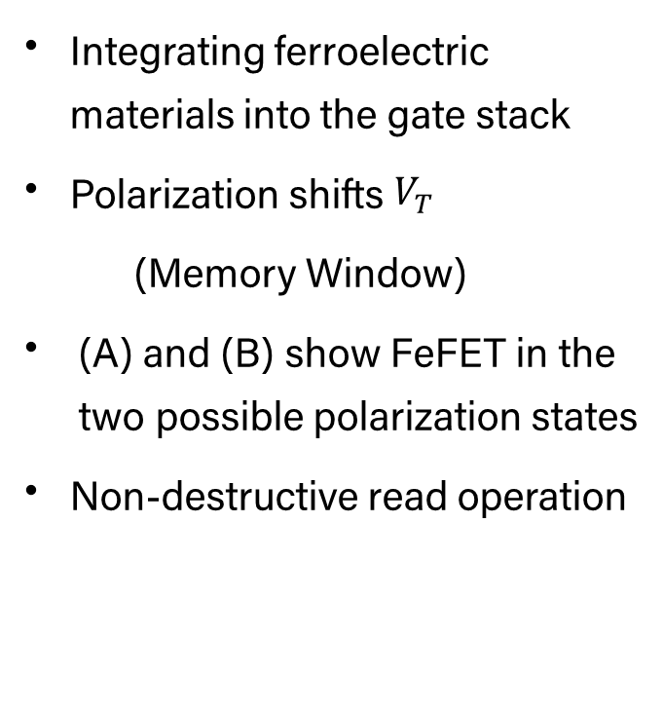
Ferroelectric Field-Effect Transistor
FeFET
Integrating ferroelectric materials into the gate stack
Polarization shifts $V_{T}$
(Memory Window)
(A) and (B) show FeFET in the two possible polarization states
Non-destructive read operation
Notes:
When integrating a ferroelectric into the gate stack of metal insulator semiconductor transistor, the switching of the dipole will shift the VT of the device as indicated in Fig C. The resulting device is called a ferroelectric field effect transistor (FeFET).
Unlike the case of a capacitor, where the polarization needs to be switched in a predefined direction during reading, the read operation is nondestructive.

Slide 6
Challenges
Miniaturization and Stability (Size Effect):
Ferroelectricity tends to weaken below critical thickness limits
CMOS Compatibility and Fabrication
High annealing temperatures and contamination risks
Endurance
Repeated switching (read/write cycles) causes degradation
Notes:
Miniaturization and Stability (Size Effect): Ferroelectricity tends to disappear or weaken below critical thickness limits. Preserving polarization in ultra-thin, nano-scale devices (such as FeRAM and FeFETs) is difficult, with domain dynamics becoming unstable.
CMOS Compatibility and Fabrication: Traditional perovskite ferroelectrics (PZT) are hard to integrate with CMOS silicon technology due to high annealing temperatures and contamination risks. While HfO₂-based ferroelectrics are better, they require complex engineering to ensure uniform phase purity and low defect densities.
Endurance and Fatigue: Repeated switching (read/write cycles) causes degradation, reducing memory life.

Slide 7
References
[1]
H. Ehrenreich, Solid State Physics, 4. Burlington: Elsevier, 1957.
[2]
M. E. Lines and A. M. Glass, Principles and applications of ferroelectrics and related materials. in The international series of monographs on physics. Oxford: Clarendon Press, 1977.
[3]
N. Locatelli, L. Herrera Diez, and T. Mikolajick, “Chapter 4 - Magnetic and ferroelectric memories,” in Memristive Devices for Brain-Inspired Computing, S. Spiga, A. Sebastian, D. Querlioz, and B. Rajendran, Eds., Woodhead Publishing, 2020, pp. 97–134. doi: 10.1016/B978-0-08-102782-0.00004-6.
[4]
G. Magagnin et al., “An Original Positive-Up-Negative-Down Protocol for Electrical Characterization of Antiferroelectric Materials,” Nano Lett., vol. 25, no. 16, pp. 6686–6692, Apr. 2025, doi: 10.1021/acs.nanolett.5c00851.

Slide 8
Thank You

